Slide 1


ACHILLIES
SYSTEM HARDENING
CHECKLIST AUTOMATION
Automated Integrity Assurance and Standards-Based Security Compliance (NIST, ISO, CIS, DISA)

Slide 2
TABLE OF CONTENTS
01
What is System Hardening?
02
Is it really important?
03
Checklist and Automated Workflow
04
Demo

Slide 3
WHAT IS SYSTEM HARDENING?

Slide 4
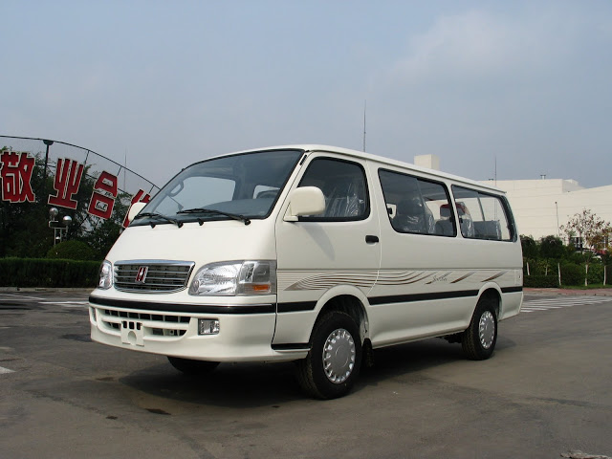
WHAT IS SYSTEM HARDENING?

Slide 5

WHAT IS SYSTEM HARDENING?

Slide 6
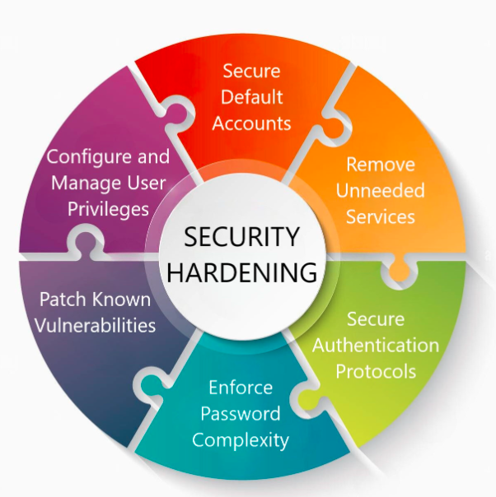
The Reality:
Endpoint Hardening is the process of securing a device (laptop, server, IoT) by reducing its "surface of vulnerability." It transforms an insecure "out-of-the-box" device into a trusted asset
The Goal:
To establish a "Root of Trust" through prescriptive configuration changes (like disabling services or enforcing encryption).
The Method:
We utilize CIS Benchmarks and DISA STIGs as prescriptive guidance.
These benchmarks provide the "Chain of Custody" required to transform a generic server or an Endpoint into a trustworthy system. (Root Of Trust)
Note:
Chain of Custody is The documentation or audit trail that proves a system has not been altered or tampered with

Slide 7
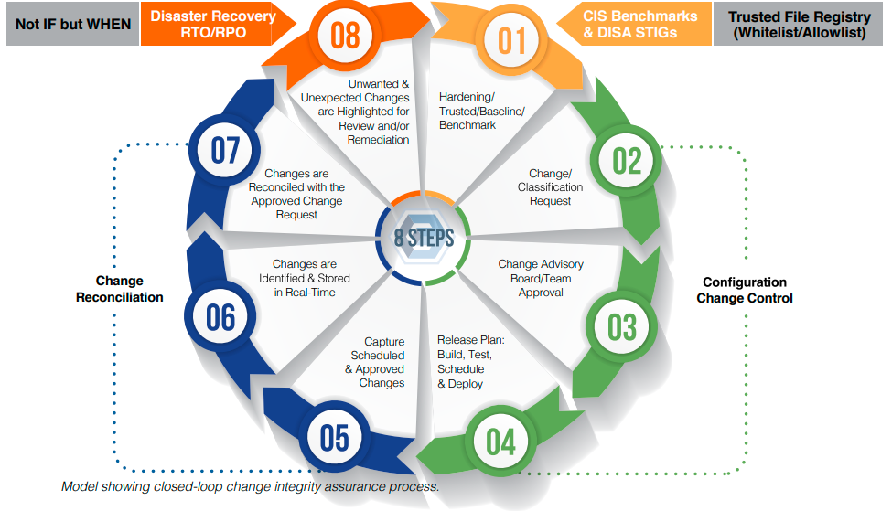

The Lifecycle
Fighting "Configuration Drift"
The Concept:
Hardening is Step 1 of a closed-loop integrity process, not a one-time checklist.
The Problem ("Drift"):
Even a fully hardened system will "drift" from its trusted state over time due to operational changes. Manually rechecking is redundant and time consuming.
The Solution:
We must establish a baseline (Step 1).
We must monitor for "Unknown & Unexpected Changes" (Step 8).
We must remediate deviations immediately to restore the Root of Trust.
Hardening without ongoing change control is equivalent to owning a plane but performing no maintenance."

Slide 8
HARDENING A SYSTEM OR DEVICE…
IS IT REALLY IMPORTANT?

Slide 9

THROUGH 2025, 99% OF CLOUD SECURITY FAILURES WILL BE THE CUSTOMER’S FAULT.
(SOURCE: GARTNER - A GLOBAL RESEARCH AND ADVISORY FIRM)
This means the software itself (Windows, AWS) isn't usually the problem!
the problem is that the customer didn't harden it correctly (e.g., left a port open, didn't disable a guest account).

Slide 10

SECURITY MISCONFIGURATION" IS CONSISTENTLY A TOP ENTRY POINT FOR ATTACKERS, CONTRIBUTING TO OVER 33% OF SUCCESSFUL SYSTEM INTRUSIONS.
(SOURCE: VERIZON DATA BREACH INVESTIGATIONS REPORT 2024)

Slide 11

BREACHES CAUSED BY "SYSTEM ERROR/MISCONFIGURATION" TOOK NEARLY 10% LONGER TO IDENTIFY AND CONTAIN THAN OTHER TYPES
THE AVERAGE COST OF A DATA BREACH REACHED AN ALL-TIME HIGH OF $4.88 MILLION IN 2024.
(SOURCE: IBM COST OF A DATA BREACH REPORT 2024)

Slide 12


HARDENING A SYSTEM OR DEVICE…
IS IT REALLY IMPORTANT?
Critical Requirement
The Inevitable Outcome
To secure and have a trustworthy device, it must be hardened to an industry standard, and the integrity of that configuration MUST be checked continuously and in real-time.
In the absence of this, one of two things is likely to happen:
You will suffer the consequences of a security breach or incident.
You will not meet or maintain the level of compliance you seek to obtain

Slide 13
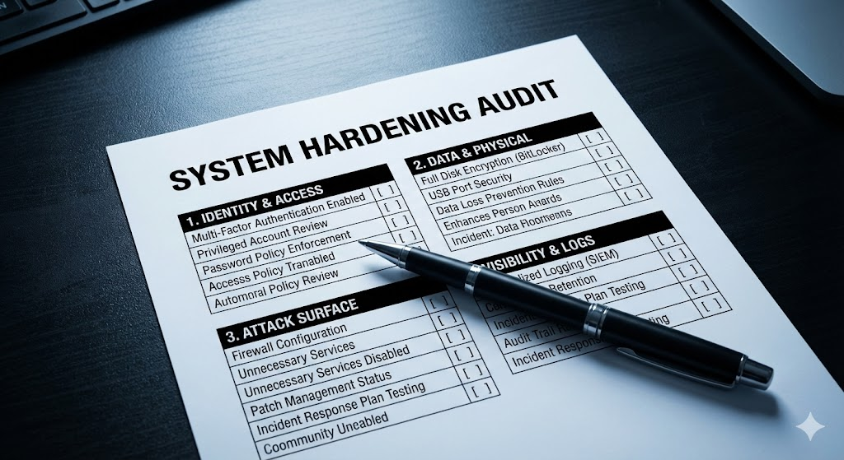
The Strategy – A Hardening Checklist
From Abstract Standards to Concrete Actions
To ensure the "Root of Trust" is never broken, we cannot rely on memory. We need a rigid Checklist of Considerations.
We have organized our hardening strategy into Four Critical Domains to ensure nothing is overlooked:
Identity & Access (User Config, Privileges).
Data Protection (Encryption, Physical Security).
Attack Surface (Network, Services, Peripherals).
Visibility (Logging, Auditing).

Slide 14


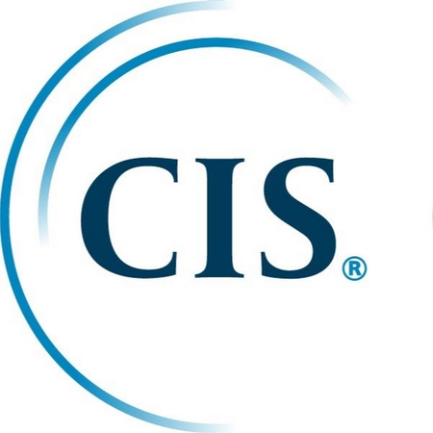

We Don't Guess. We Follow Global Mandates.
We map our hardening checklist to the "Big Four":
NIST SP 800-53: The Gold Standard for Federal Systems
(Focus on Access Control).
ISO/IEC 27001: International Standard for Information Security
(Focus on Operations Security).
DISA STIGs: Defense Information Systems Agency
Security Technical Implementation Guides
CIS Benchmarks: The industry standard for secure configuration.

Slide 15
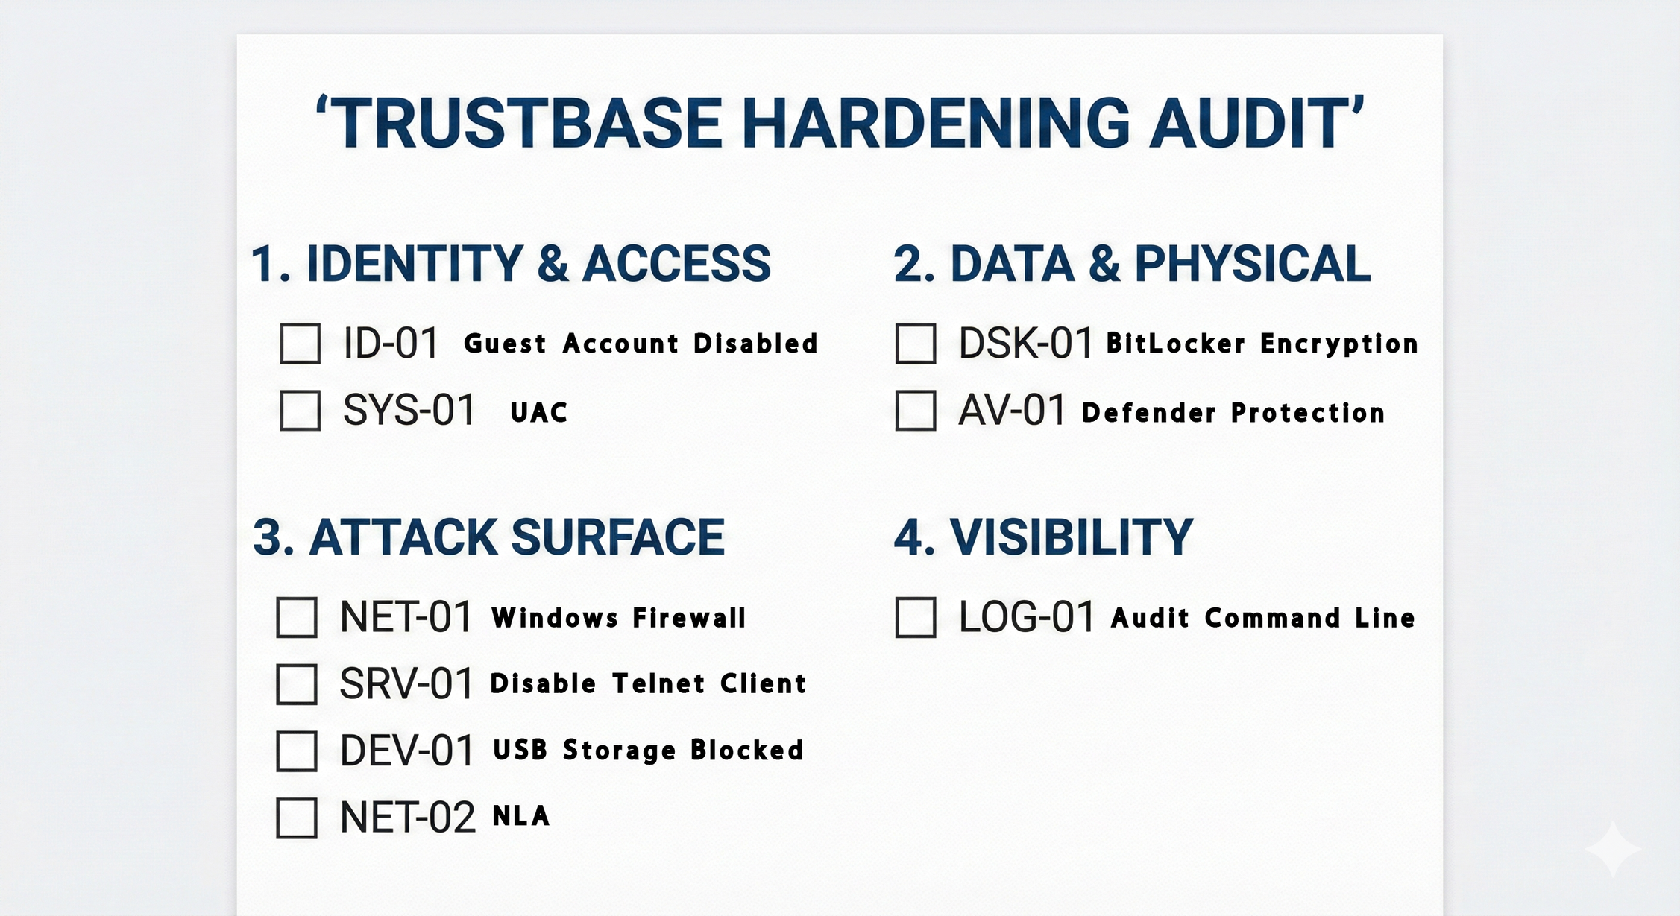

Slide 16
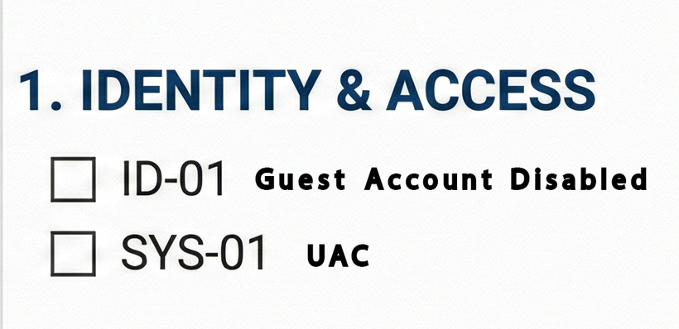
Deep Dive
Domain 1 – Identity & Access Management
The Concept:
The easiest way into a system is a weak user account.
The Checklist Action:
Disable Guest Accounts: Remove anonymous access vectors.
Enforce Least Privilege: Use UAC to stop silent privilege elevation.
The Standards:
NIST (AC-2): Account Management.
ISO 27001 (A.9.2.1): User Registration/De-registration.
DISA STIG: "Guest Account Status must be Disabled."

Slide 17
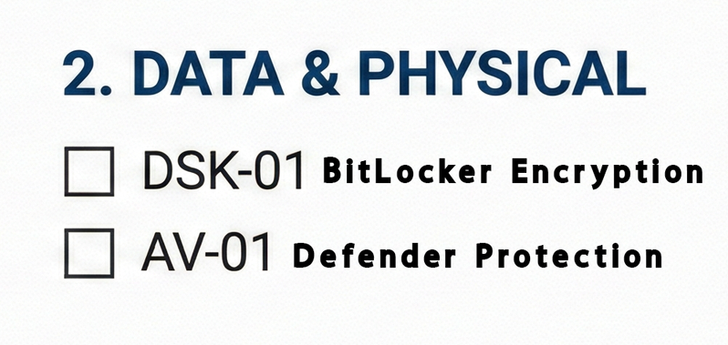
Deep Dive
Domain 2 – Physical & Data Security
The Concept:
If physical access is gained, software firewalls are useless.We need to Control Encryption at Rest
The Checklist Action:
Full Disk Encryption: Ensure the OS drive is encrypted (BitLocker).
The Standards:
NIST 800-171 (3.13.11): Use FIPS-validated cryptography to protect confidentiality.
CIS Benchmark: Ensure BitLocker Drive Encryption is Enabled.

Slide 18
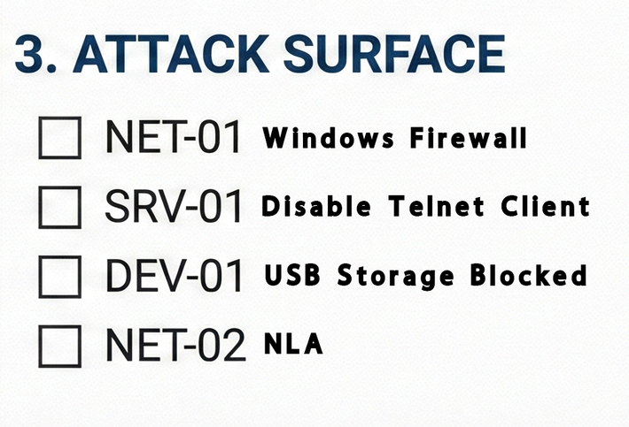
Deep Dive
Domain 3 – Reducing the Attack Surface
The Concept:
If it's not running, it can't be hacked.
The Checklist Action:
Network: Enable Firewalls (NET-01).
Services: Kill legacy protocols like Telnet and Spooler (SRV-01).
Peripherals: Block USB Storage at the Registry level (DEV-01).
The Standards:
NIST (CM-7): Least Functionality – Configure systems to provide only essential capabilities.
ISO 27001 (A.12.6.1): Technical Vulnerability Management.

Slide 19
TILL NOW NICE, WHAT ABOUT THE AUTOMATION?

Slide 20


Slide 21

A POWERSHELL-BASED CHECKLIST AUTOMATION ENGINE
The Workflow:
Audit:
Scans system against the NIST/CIS/Cimcor Baseline.
Report:
Generates the HTML Compliance Report (Pass/Fail) you see here.
Remediate:
Automatically applies fixes to restore trust.
The Result:
A system that is not just "Secure," but Hardened and Compliant with international standards

